Slide 1
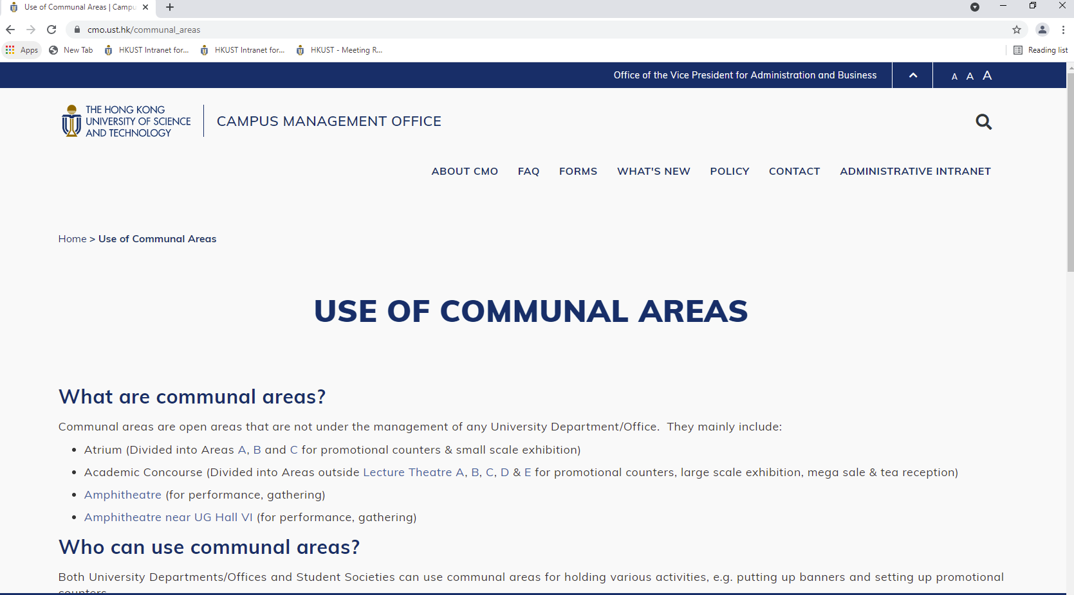
CMO Webpage: https://cmo.ust.hk/communal_areas

Slide 2
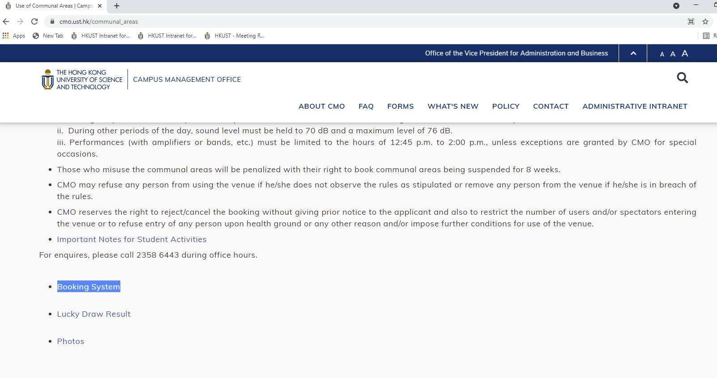
CMO Webpage: https://w5.ab.ust.hk/wrm/app/login

Slide 3
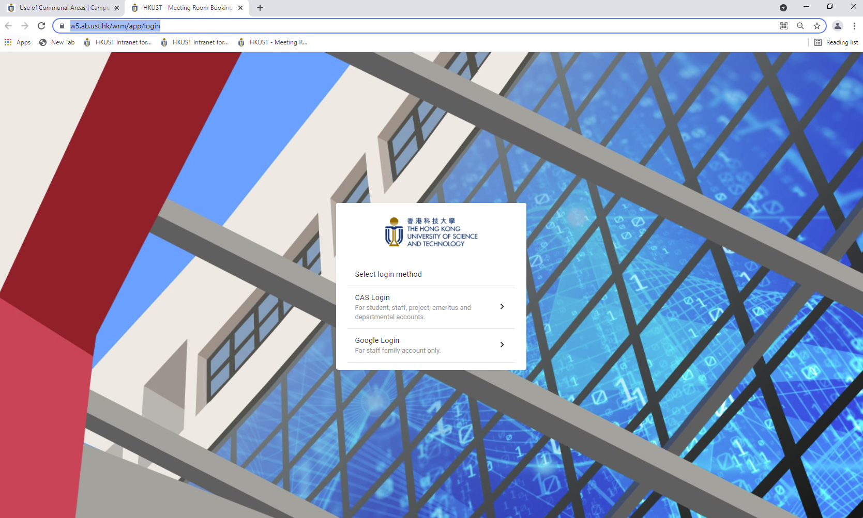
Please login CAS with your society ITSC account e.g. “su_union@connect.ust.hk”

Slide 4
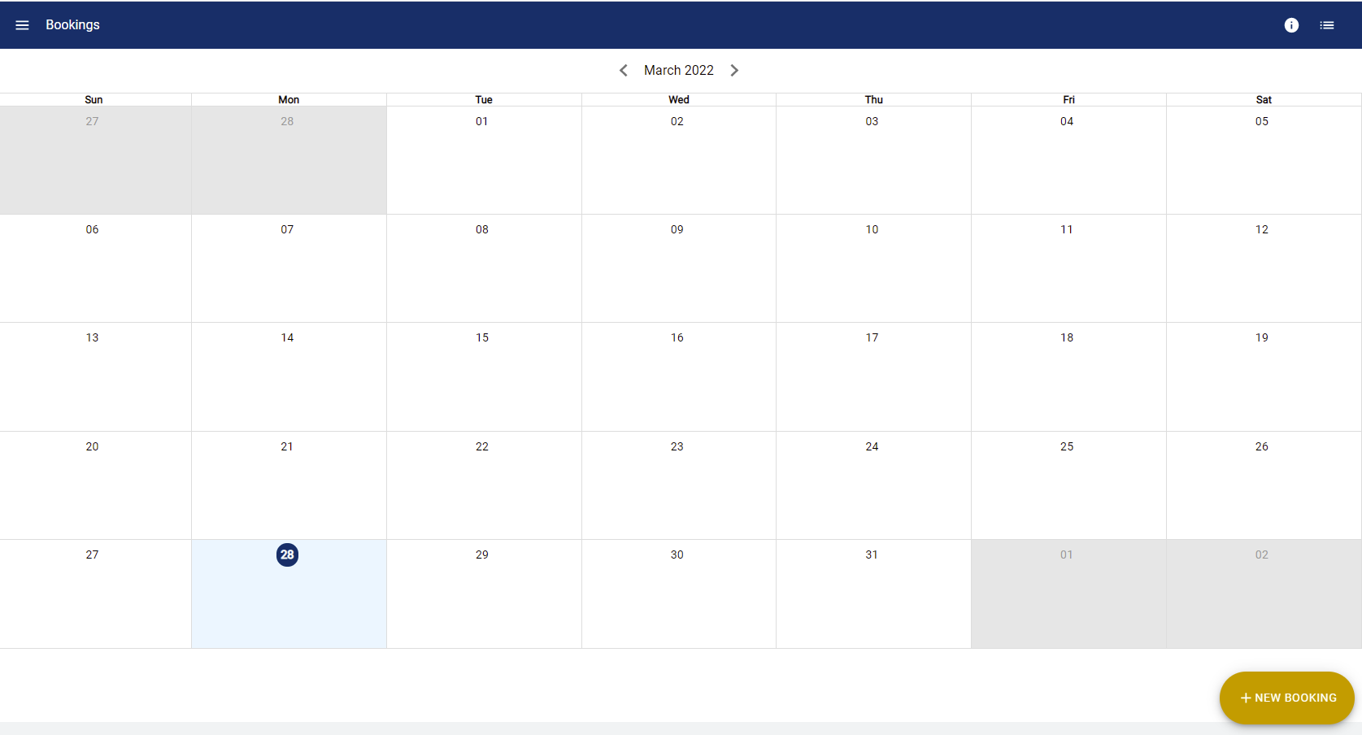
Click New Booking

Slide 5
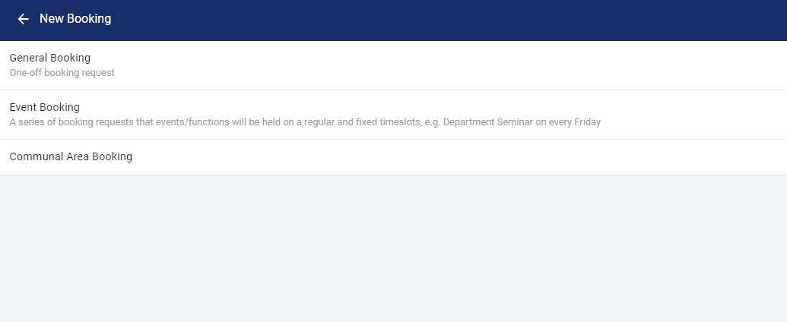
Click Communal Area Booking

Slide 6
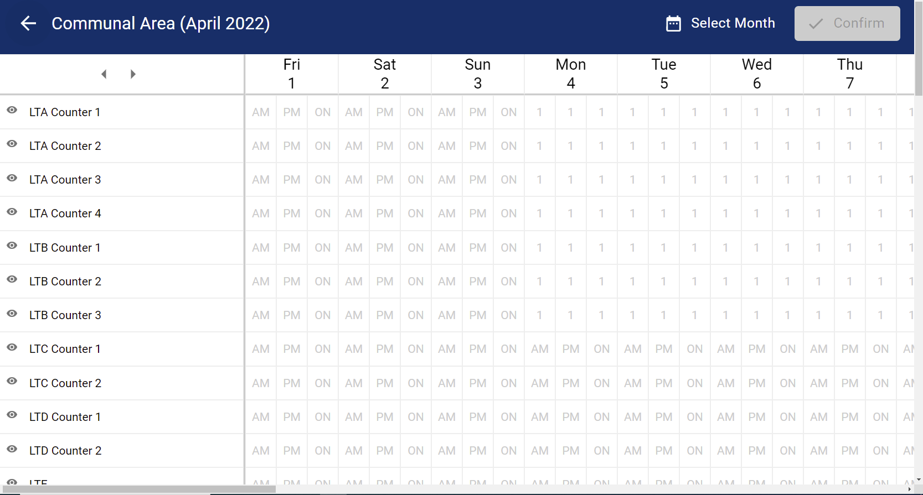

Slide 7
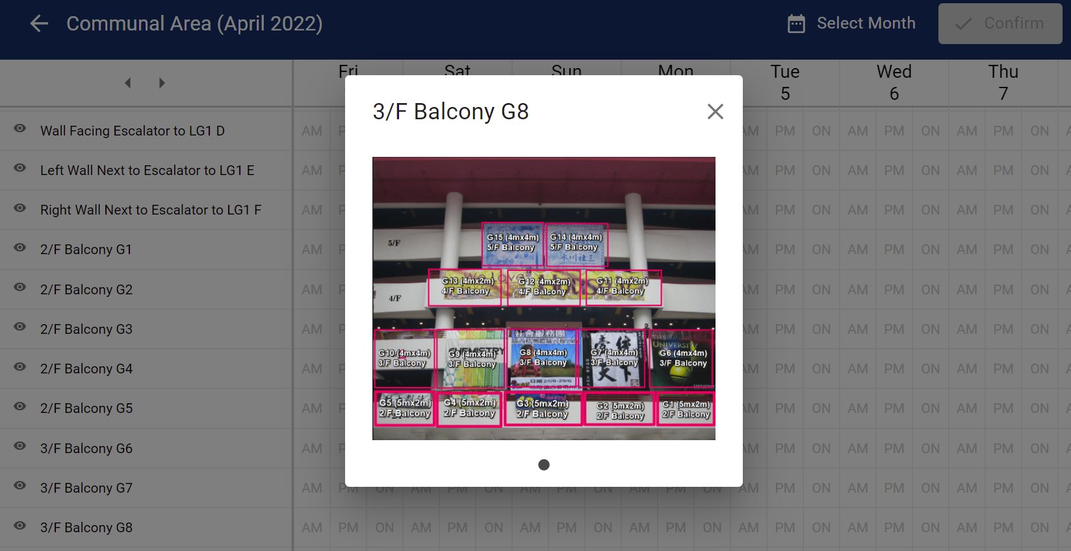

Slide 8
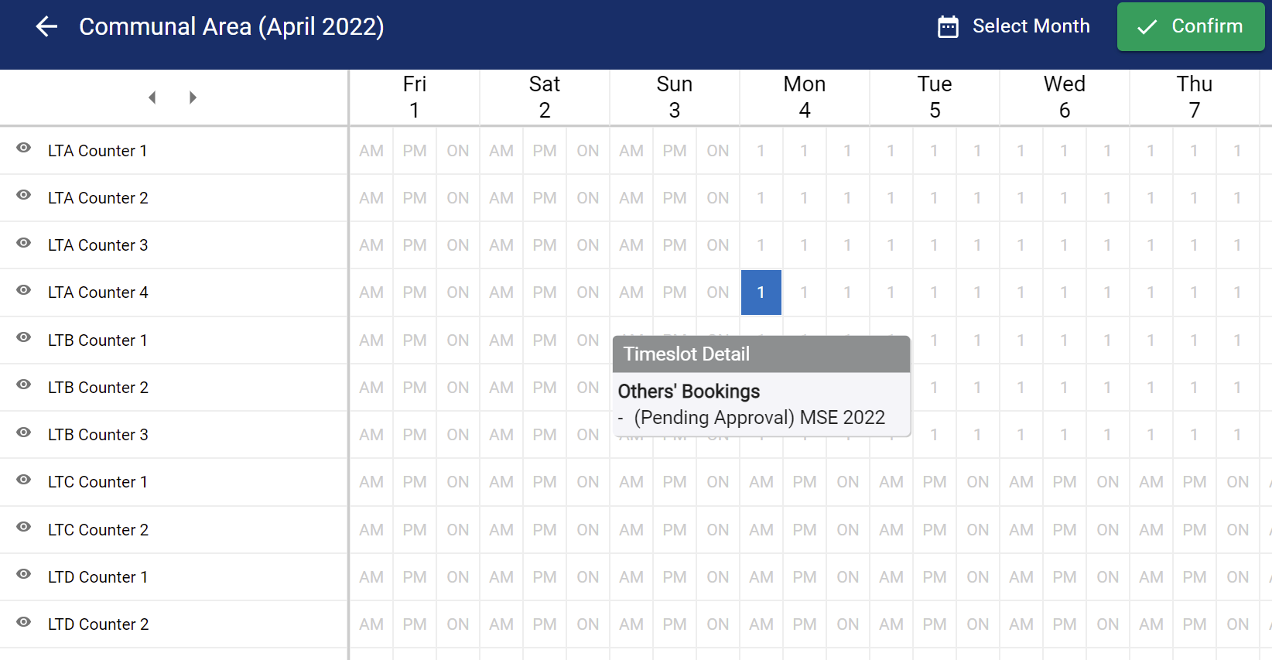
Place the cursor on the cell to check the booking status

Slide 9
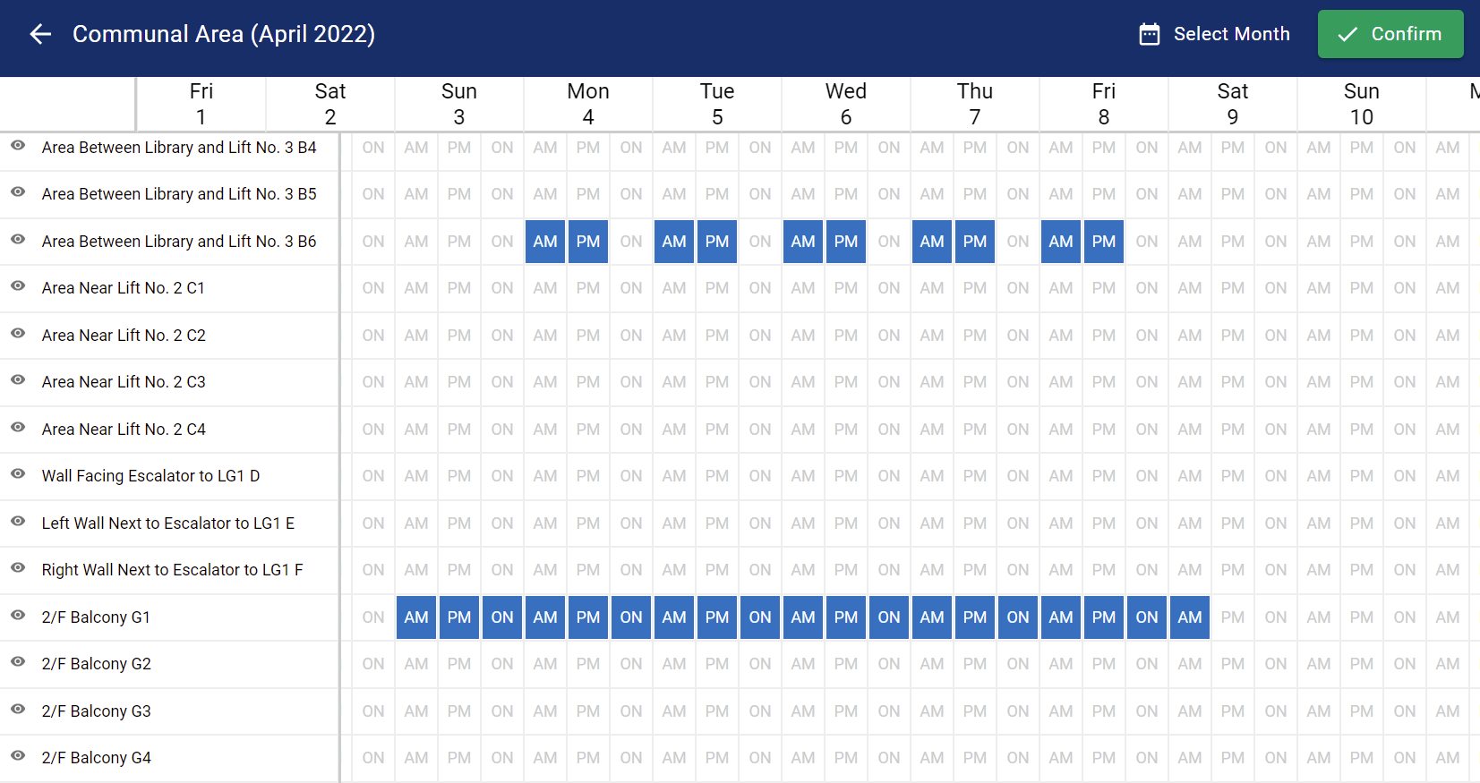
Select the venue and click confirm

Slide 10
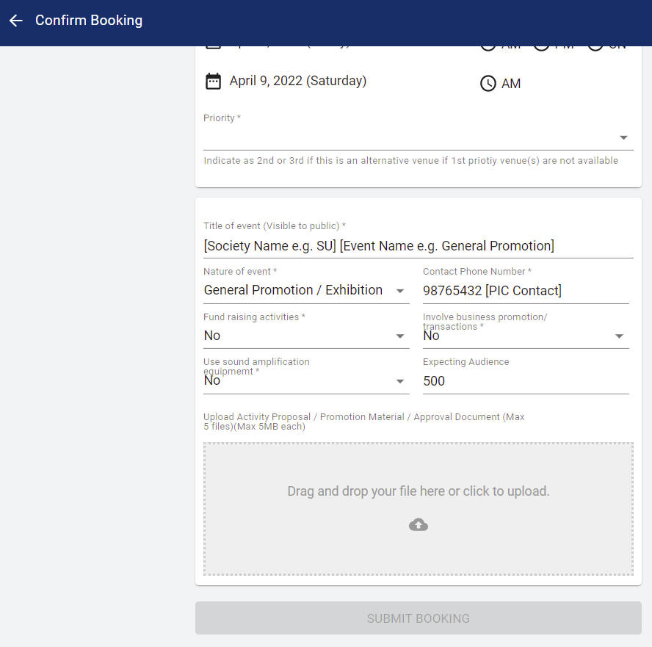
Must-fill Blanks

Slide 11
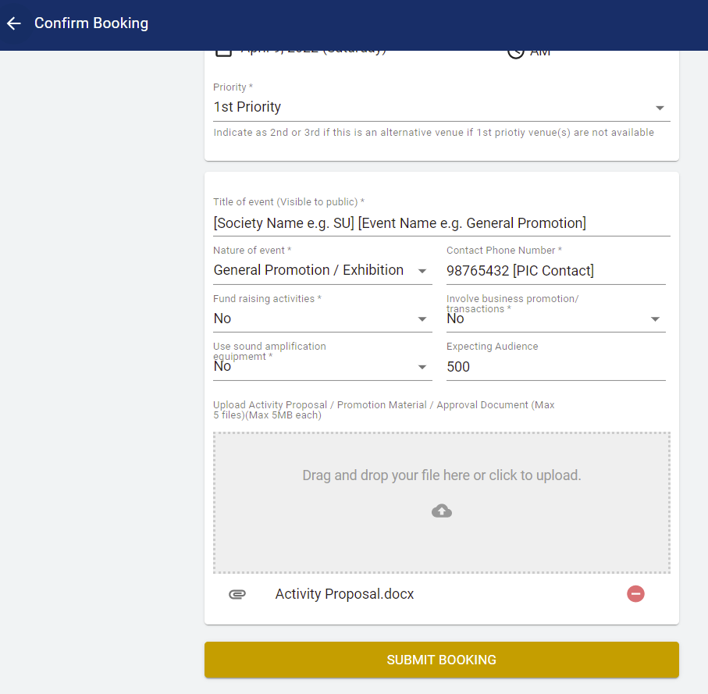
[Example Only] Proposal for Venue Booking
Details of users:
Name of Society:
Contact of Person in Charge (PIC):
Event Details:
Name of Activity:
Nature of Activity:
Venues for Booking:
Date:
Time:
Detail Event Rundown:
0900-1000: Venue set up
1000-1030: Registration
1030-1130: Sharing of speaker 1
1130-1230: Sharing of speaker 2
1230-1300: Event close and venue clean up
1300-1330: Venue reinstate
1330-1400: Return equipment
C. Participant Details:
Target Participants:
Expected no. of Participants:
Any non-HKUST participants: (who are they and what will they do in the event?)
D. Others:
Floor plan
Promotion materials e.g. banner / poster design
You may submit booking when all blanks are filled

